Slide 1
Chapter 9 – Elliptic Curve Cryptography

Slide 2
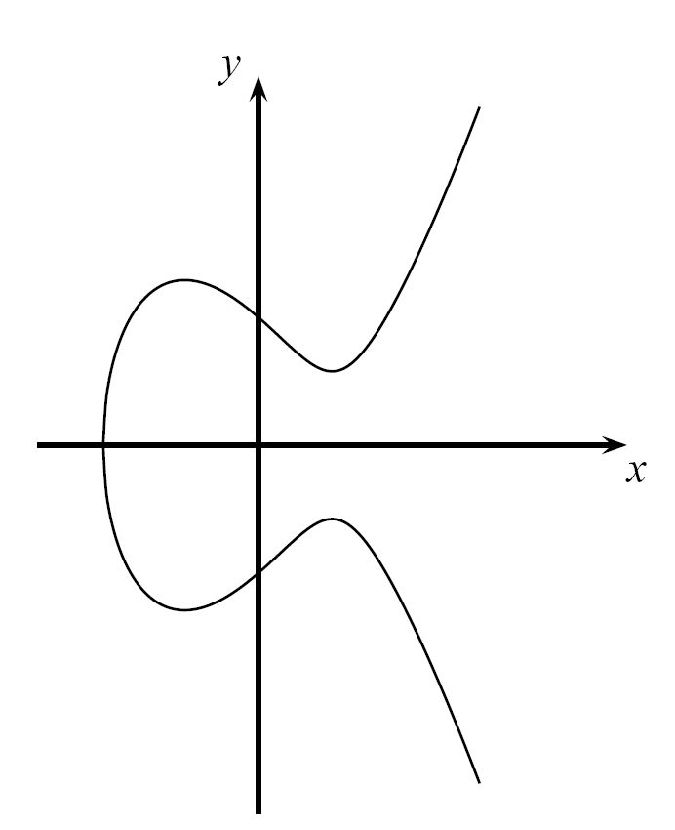
Content of this Chapter
Introduction
Computations on Elliptic Curves
The Elliptic Curve Diffie-Hellman Protocol
Security Aspects
Implementation in Software and Hardware

Slide 3
Content of this Chapter
Introduction
Computations on Elliptic Curves
The Elliptic Curve Diffie-Hellman Protocol
Security Aspects
Implementation in Software and Hardware
Chapter 9 of Understanding Cryptography by Christof Paar and Jan Pelzl

Slide 4
Motivation
Problem: Asymmetric schemes like RSA and Elgamal require exponentiations in integer rings and fields with parameters of more than 1000 bits.
High computational effort on CPUs with 32-bit or 64-bit arithmetic
Large parameter sizes critical for storage on small and embedded
Motivation: Smaller field sizes providing equivalent security are desirable
Solution: Elliptic Curve Cryptography uses a group of points (instead of integers) for cryptographic schemes with coefficient sizes of 160-256 bits, reducing significantly the computational effort.
Chapter 9 of Understanding Cryptography by Christof Paar and Jan Pelzl
Notes:
4

Slide 5
Content of this Chapter
Introduction
Computations on Elliptic Curves
The Elliptic Curve Diffie-Hellman Protocol
Security Aspects
Implementation in Software and Hardware
Chapter 9 of Understanding Cryptography by Christof Paar and Jan Pelzl

Slide 6
Computations on Elliptic Curves
Elliptic curves are polynomials that define points based on the (simplified) Weierstrass equation:
y² = x³ + ax + b
for parameters a,b that specify the exact shape of the curve
On the real numbers and with parameters a, b R, an elliptic curve looks like this →
Elliptic curves can not just be defined over the real numbers R but over many other types of finite fields.
Example: y² = x³ −3x+3 over R
Chapter 9 of Understanding Cryptography by Christof Paar and Jan Pelzl

Slide 7

Computations on Elliptic Curves (ctd.)
In cryptography, we are interested in elliptic curves module a prime p:
Note that Z_{p} = {0,1,…, p -1} is a set of integers with modulo p arithmetic
Definition: Elliptic Curves over prime fields
The elliptic curve over Z_{p}, p>3 is the set of all pairs (x,y) Z_{p} which fulfill y² = x³ + ax + b mod p together with an imaginary point of infinity θ, where a,b Z_{p} and the condition 4a³+27b² ≠ 0 mod p.
Chapter 9 of Understanding Cryptography by Christof Paar and Jan Pelzl
Notes:
7

Slide 8
Computations on Elliptic Curves (ctd.)
Some special considerations are required to convert elliptic curves into a group of points
In any group, a special element is required to allow for the identity operation, i.e., given P E: P + θ = P = θ + P
This identity point (which is not on the curve) is additionally added to the group definition
This (infinite) identity point is denoted by θ
Elliptic Curve are symmetric along the x-axis
Up to two solutions y and -y exist for each x of the elliptic curve
For each point P =(x,y), the inverse or negative point is defined as -P =(x,-y)
point at
infinity
θ
P
-P
θ
point at
infinity
Chapter 9 of Understanding Cryptography by Christof Paar and Jan Pelzl
Notes:
8

Slide 9
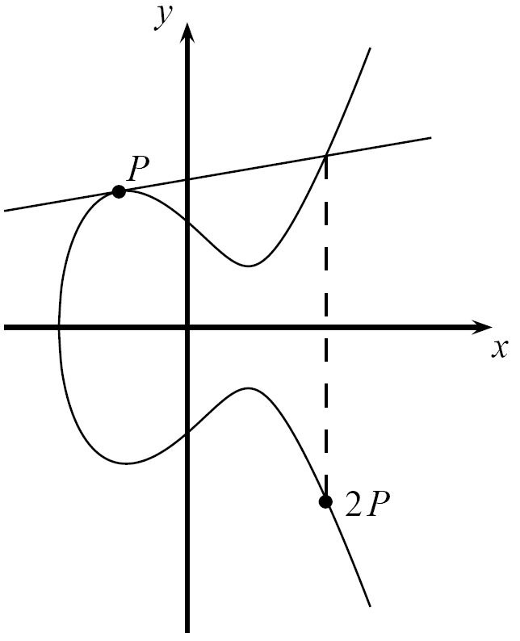
Computations on Elliptic Curves (ctd.)
Generating a group of points on elliptic curves based on point addition operation P+Q = R, i.e., (x_{P},y_{P})+(x_{Q},y_{Q}) = (x_{R},y_{R})
Geometric Interpretation of point addition operation
Draw straight line through P and Q; if P=Q use tangent line instead
Mirror third intersection point of drawn line with the elliptic curve along the x-axis
Elliptic Curve Point Addition and Doubling Formulas
Point Addition
x₃ = s² −x₁−x₂ mod p and y₃ = s(x₁ −x₃)−y₁ mod p
where
s =
Point Doubling
; if P ≠ Q (point addition)
; if P = Q (point doubling)
=P+P
Chapter 9 of Understanding Cryptography by Christof Paar and Jan Pelzl
Notes:
9

Slide 10
Computations on Elliptic Curves (ctd.)
Example: Given E: y² = x³+2x+2 mod 17 and point P=(5,1) Goal: Compute 2P = P+P = (5,1)+(5,1)= (x₃,y₃)
s = = (2 · 1)⁻¹(3 · 5² + 2) = 2⁻¹ · 9 ≡ 9 · 9 ≡ 13 mod 17
x₃ = s² − x₁ − x₂ = 13² − 5 − 5 = 159 ≡ 6 mod 17 y₃ = s(x₁−x₃) − y₁ = 13(5 − 6) − 1= −14 ≡ 3 mod 17
Finally 2P = (5,1) + (5,1) = (6,3)
Chapter 9 of Understanding Cryptography by Christof Paar and Jan Pelzl

Slide 11
Computations on Elliptic Curves (ctd.)
The points on an elliptic curve and the point at infinity θ form cyclic subgroups 2P = (5,1)+(5,1) = (6,3) 11P = (13,10) 3P = 2P+P = (10,6) 12P = (0,11) 4P = (3,1) 13P = (16,4) 5P = (9,16) 14P = (9,1) 6P = (16,13) 15P = (3,16) 7P = (0,6) 16P = (10,11) 8P = (13,7) 17P = (6,14) 9P = (7,6) 18P = (5,16) 10P = (7,11) 19P = θ
This elliptic curve has order #E = |E| = 19 since it contains 19 points in its cyclic group.
P
θ
Chapter 9 of Understanding Cryptography by Christof Paar and Jan Pelzl

Slide 12
Number of Points on an Elliptic Curve
How many points can be on an arbitrary elliptic curve?
Consider previous example: E: y² = x³+2x+2 mod 17 has 19 points
However, determining the point count on elliptic curves in general is hard
But Hasse‘s theorem bounds the number of points to a restricted interval
Definition: Hasse‘s Theorem:
Given an elliptic curve module p, the number of points on the curve is denoted by #E and is bounded by p+1-2 ≤ #E ≤ p+1+2
Interpretation: The number of points is „close to“ the prime p
Example: To generate a curve with about 2¹⁶⁰ points, a prime with a length of about 160 bits is required
Chapter 9 of Understanding Cryptography by Christof Paar and Jan Pelzl

Slide 13
Elliptic Curve Discrete Logarithm Problem
Cryptosystems rely on the hardness of the Elliptic Curve Discrete Logarithm Problem (ECDLP)
Definition: Elliptic Curve Discrete Logarithm Problem (ECDLP)
Given a primitive element P and another element T on an elliptic curve E. The ECDL problem is finding the integer d, where 1 ≤ d ≤ #E such that P + P +…+ P = dP = T.
d times
Cryptosystems are based on the idea that d is large and kept secret and attackers cannot compute it easily
If d is known, an efficient method to compute the point multiplication dP is required to create a reasonable cryptosystem
Known Square-and-Multiply Method can be adapted to Elliptic Curves
The method for efficient point multiplication on elliptic curves: Double-and-Add Algorithm
Chapter 9 of Understanding Cryptography by Christof Paar and Jan Pelzl

Slide 14
Double-and-Add Algorithm for Point Multiplication
Double-and-Add Algorithm
Input: Elliptic curve E, an elliptic curve point P and a scalar d with bits d_{i} Output: T = d P
Initialization:
T = P
Algorithm:
FOR i = t −1 DOWNTO 0
T = T +T mod n
IF d_{i} = 1
T = T +P mod n
RETURN (T)
Example: 26P = (11010₂)P = (d₄d₃d₂d₁d₀)₂ P.
Step
#0 P = 1₂P inital setting
#1a P+P = 2P = 10₂P DOUBLE (bit d₃)
#1b 2P+P = 3P = 10² P+1₂P = 11₂P ADD (bit d₃=1)
#2a 3P+3P = 6P = 2(11₂P) = 110₂P DOUBLE (bit d₂)
#2b no ADD (d₂ = 0)
#3a 6P+6P = 12P = 2(110₂P) = 1100₂P DOUBLE (bit d₁)
#3b 12P+P = 13P = 1100₂P+1₂ P = 1101₂P ADD (bit d₁=1)
#4a 13P+13P = 26P = 2(1101₂P) = 11010₂P DOUBLE (bit d₀)
#4b no ADD (d₀ = 0)
Chapter 9 of Understanding Cryptography by Christof Paar and Jan Pelzl

Slide 15
Content of this Chapter
Introduction
Computations on Elliptic Curves
The Elliptic Curve Diffie-Hellman Protocol
Security Aspects
Implementation in Software and Hardware
Chapter 9 of Understanding Cryptography by Christof Paar and Jan Pelzl

Slide 16
The Elliptic Curve Diffie-Hellman Key Exchange (ECDH)
Given a prime p, a suitable elliptic curve E and a point P=(x_{P},y_{P})
The Elliptic Curve Diffie-Hellman Key Exchange is defined by the following protocol:
Joint secret between Alice and Bob: T_{AB} = (x_{AB}, y_{AB})
Proof for correctness:
Alice computes aB=a(bP)=abP
Bob computes bA=b(aP)=abP since group is associative
One of the coordinates of the point T_{AB} (usually the x-coordinate) can be used as session key (often after applying a hash function)
Alice
Choose k_{PrA}= a {2, 3,…, #E-1}
Compute k_{PubA}= A = aP = (x_{A},y_{A})
Compute aB = T_{ab}
Bob
Choose k_{PrB}= b {2, 3,…, #E-1}
Compute k_{PubB}= B = bP = (x_{B},y_{B})
Compute bA = T_{ab}
A
B
Chapter 9 of Understanding Cryptography by Christof Paar and Jan Pelzl

Slide 17
The Elliptic Curve Diffie-Hellman Key Exchange (ECDH) (ctd.)
The ECDH is often used to derive session keys for (symmetric) encryption
One of the coordinates of the point T_{AB} (usually the x-coordinate) is taken as session key
In some cases, a hash function (see next chapters) is used to derive the session key
Alice
Choose k_{PrA}= a {2, 3,…, #E-1}
Compute k_{PubA}= A = aP = (x_{A},y_{A})
Compute aB = T_{ab} = (x_{T},y_{T})
Define key k_{AES} = x_{T}
Given a message m:
Encrypt c = AES_{kAES}(m)
Bob
Choose k_{PrB}= b {2, 3,…, #E-1}
Compute k_{PubB}= B = bP = (x_{B},y_{B})
Compute bA = T_{ab}= (x_{T},y_{T})
Define key k_{AES} = x_{T}
Received ciphertext c:
Decrypt m = AES⁻¹_{kAES}(c)
A
ECDH
B
c
Symmetric encryption/decryption
Chapter 9 of Understanding Cryptography by Christof Paar and Jan Pelzl

Slide 18
Content of this Chapter
Introduction
Computations on Elliptic Curves
The Elliptic Curve Diffie-Hellman Protocol
Security Aspects
Implementation in Software and Hardware
Chapter 9 of Understanding Cryptography by Christof Paar and Jan Pelzl

Slide 19
Security Aspects
Why are parameters signficantly smaller for elliptic curves (160-256 bit) than for RSA (1024-3076 bit)?
Attacks on groups of elliptic curves are weaker than available factoring algorithms or integer DL attacks
Best known attacks on elliptic curves (chosen according to cryptographic criterions) are the Baby-Step Giant-Step and Pollard-Rho method
Complexity of these methods: on average, roughly steps are required before the ECDLP can be successfully solved
Implications to practical parameter sizes for elliptic curves:
An elliptic curve using a prime p with 160 bit (and roughly 2¹⁶⁰ points) provides a security of 2⁸⁰ steps that required by an attacker (on average)
An elliptic curve using a prime p with 256 bit (roughly 2²⁵⁶ points) provides a security of 2¹²⁸ steps on average
Chapter 9 of Understanding Cryptography by Christof Paar and Jan Pelzl

Slide 20
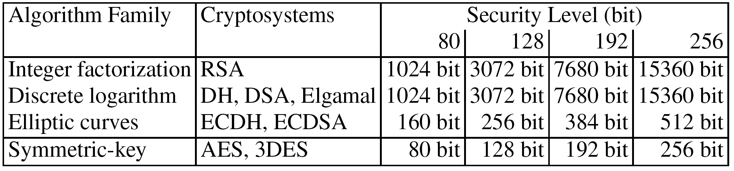
Bit lengths of Public-key Algorithms

Slide 21
Content of this Chapter
Introduction
Computations on Elliptic Curves
The Elliptic Curve Diffie-Hellman Protocol
Security Aspects
Implementation in Software and Hardware
Chapter 9 of Understanding Cryptography by Christof Paar and Jan Pelzl

Slide 22
Implementations in Hardware and Software
Elliptic curve computations usually regarded as consisting of four layers:
Basic modular arithmetic operations are computationally most expensive
Group operation implements point doubling and point addition
Point multiplication can be implemented using the Double-and-Add method
Upper layer protocols like ECDH and ECDSA
Most efforts should go in optimizations of the modular arithmetic operations, such as
Modular addition and subtraction
Modular multiplication
Modular inversion
Chapter 9 of Understanding Cryptography by Christof Paar and Jan Pelzl

Slide 23
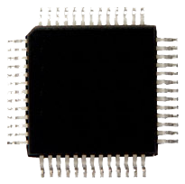
Implementations in Hardware and Software
Software implementations
Optimized 256-bit ECC implementation on 3GHz 64-bit CPU requires about 2 ms per point multiplication
Less powerful microprocessors (e.g, on SmartCards or cell phones) even take significantly longer (>10 ms)
Hardware implementations
High-performance implementations with 256-bit special primes can compute a point multiplication in a few hundred microseconds on reconfigurable hardware
Dedicated chips for ECC can compute a point multiplication even in a few ten microseconds
HW
SW
Chapter 9 of Understanding Cryptography by Christof Paar and Jan Pelzl

Slide 24
Lessons Learned
Elliptic Curve Cryptography (ECC) is based on the discrete logarithm problem. It requires, for instance, arithmetic modulo a prime.
ECC can be used for key exchange, for digital signatures and for encryption.
ECC provides the same level of security as RSA or discrete logarithm systems over Z_{p} with considerably shorter operands (approximately 160–256 bit vs. 1024–3072 bit), which results in shorter ciphertexts and signatures.
In many cases ECC has performance advantages over other public-key algorithms.
ECC is slowly gaining popularity in applications, compared to other public-key schemes, i.e., many new applications, especially on embedded platforms, make use of elliptic curve cryptography.

Slide 25
中国商用密码算法SM2椭圆曲线公钥密码加密算法
SM2是中国国家密码管理局颁布的中国商用公钥密码标准算法，它是一组椭圆曲线密码算法，其中包含加解密算法、数字签名算法。
SM2算法与国际标准的ECC算法比较：
ECC算法通常采用NIST等国际机构建议的曲线及参
数，而SM2算法的参数需要利用一定的算法产生。而由于算法中加入了用户特异性的曲线参数、基点、用户的公钥点信息，故使得SM2算法的安全性明显提高。
(2) 在ECC算法中，用户可以选择MD5或SHA-1等国际通用的哈希算法。而SM2算法中则使用SM3哈希算法，SM3算法输出为256 比特，其安全性与SHA-256算法基本相当。

Slide 26
SM2算法分为基于素数域和基于二元扩域两种。本文仅介绍基于素数域的SM2算法。
1. 基本参数
基于素数域 的SM2算法参数如下：
的特征 ，为 比特长的素数 ， 要尽可能大，但太大会影响计算速度;
长度不小于192比特的比特串 ;
上的2个元素 ，满足 ，定义曲线
；
基点 ；
的阶 为 比特长的素数，满足 且 ；
称为余因子，其中 是曲线 的点数。

Slide 27
和 的产生算法如下：
（1）任意选取长度不小于192比特的比特串 ;
（2）计算 ，记 ，其中
表示256比特输出的SM3哈希算法；
（3）取 ；
（4）取 ；
（5）在 上任意选择2个元素 ，满足 ；
（6）若 ，则转向 （1）；
（7）所选择的 上曲线是 ；
（8）输出 。

Slide 28
2. 密钥产生
设接收方为 B，B 的秘密钥取为 中的一个随机数 ，记为 ，其中 n 是基点 的阶。
B 的公开钥取为椭圆曲线上的点：
其中 是基点。
3. 加密算法
设发送方是 A ，A 要发送的消息表示成比特串 ，
的长度为 。加密运算如下：
（1）选择随机数 ；
（2）计算椭圆曲线点 ，将 表示为比
特串；

Slide 29
（3）计算椭圆曲线点 ，若 是无穷远点，则报错并
退出；
（4）计算椭圆曲线点 ，将 表示为比特串；
（5）计算 ，若 为全 0 的比特串，则返
回（1）；
（6）计算 ；
（7）计算 ；
（8）输出密文 。
其中第（5）步 是 密钥派生函数，其本质上就是一个伪随机数产生函数，用来产生密钥，取为密码哈希函数SM3。第（3）步 函数也取为SM3。
图4-5是 加密算法的流程图。

Slide 30
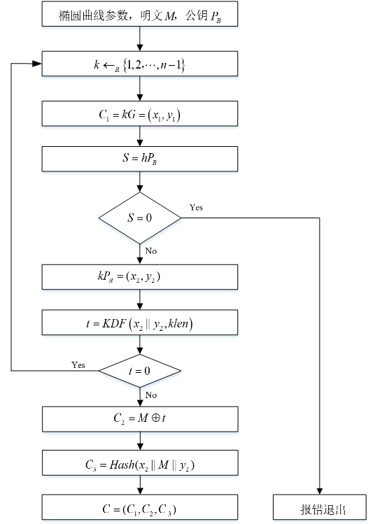
图 SM2加密流程图

Slide 31
4. 解密算法
B 收到密文后，执行以下解密运算：
（1）从 中取出比特串 ，将 表示为椭圆曲线上的点，
验证 是否满足椭圆曲线方程，若不满足则报错并
退出；
（2）计算椭圆曲线点 ，若 是无穷远点，则报错并
退出；
（3）计算 ，将坐标 ， 表示为比特串；
（4）计算 ，若 为全0比特串，则报错并
退出；
（5）从 中取出比特串 ，计算 ；
（6）计算 ，从 中取出 ，若 ，则
报错并退出；
（7）输出明文 。

Slide 32
图4-6是SM2解密算法的流程图。
解密的正确性：
因为 ， ，由解密算法的第（3）步可得
所以解密算法第（4）步得到的 与加密算法第（5）步得到的 相等，由 ，便得到明文 。

Slide 33
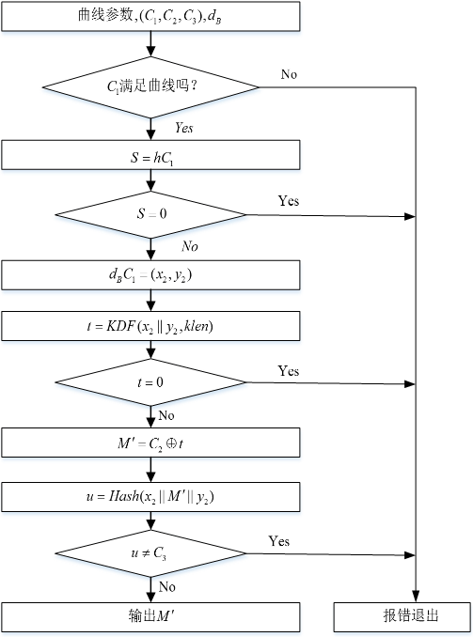
图 SM2解密流程图

